Slide 1
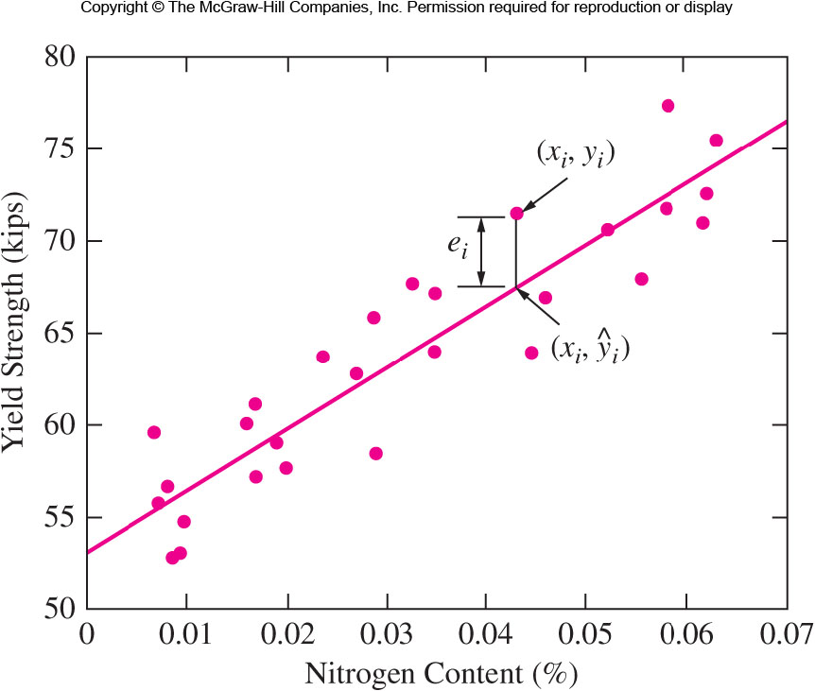

Figure 2.7 Yield strength versus nitrogen content for a sample of welds
$${\hat{y}}_{i}={\hat{β}}_{0}+{\hat{β}}_{1}x_{i}$$

Slide 2

Method of Least Squares (MLS)
https://mathworld.wolfram.com/LeastSquaresFitting.html
min $\sum{e_{i}^{2}}=\sum{{\left(y_{i}−{\hat{β}}_{0}−{\hat{β}}_{1}x_{i}\right)}^{2}}$
Let
$\overline{y}=\frac{1}{n}\sum_{i=1}^{n}{y_{i},}$ $\overline{x}=\frac{1}{n}\sum_{i=1}^{n}{x_{i},}$
$S_{xx}=\sum_{i=1}^{n}{{\left(x_{i}−\overline{x}\right)}^{2}}$
$S_{xy}=\sum_{i=1}^{n}{\left(x_{i}−\overline{x}\right)\left(y_{i}−\overline{y}\right)}$
Solve the MLS equations, we obtain that
${\hat{β}}_{1}=\frac{S_{xy}}{S_{xx}}$ ${\hat{β}}_{0}=\overline{y}−{\hat{β}}_{1}\overline{x}$

Slide 3
Example 12.4
The cetane number is a critical property in specifying the ignition quality of a fuel used in a diesel engine.
Determination of this number for a biodiesel fuel is expensive and time-consuming.
Therefore a way of predicting this number is wanted.
The data on the table is x = iodine value (g) and y = cetane number for a sample of 14 biofuels.
The iodine value is the amount of iodine necessary to saturate a sample of 100g of oil.
> x <- c(132.0, 129.0, 120.0, 113.2, 105.0, 92.0, 84.0, 83.2, 88.4, 59.0, 80.0, 81.5, 71.0, 69.2)
> y <- c(46.0, 48.0, 51.0, 52.1, 54.0, 52.0, 59.0, 58.7, 61.6, 64.0, 61.4, 54.6, 58.8, 58.0)
> f <- lm(y~x)
x | 132.0 129.0 120.0 113.2 105.0 92.0 84.0 83.2 88.4 59.0 80.0 81.5 71.0 69.2
y | 46.0 48.0 51.0 52.1 54.0 52.0 59.0 58.7 61.6 64.0 61.4 54.6 58.8 58.0

Slide 4
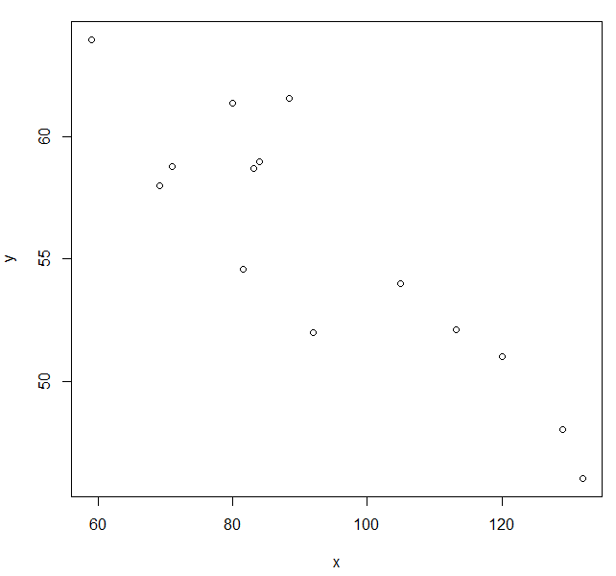

Slide 5
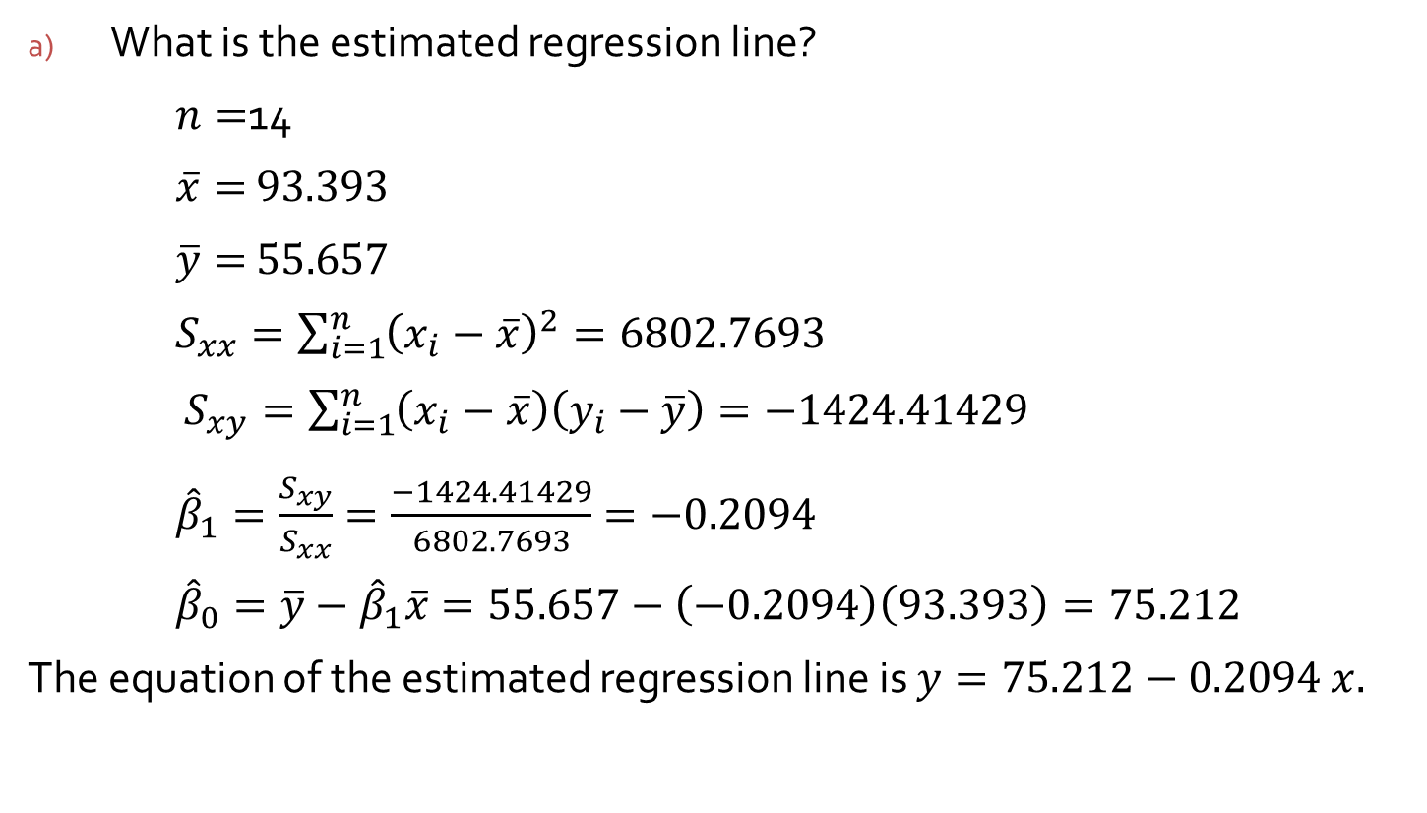
Steps in the analysis
What is the estimated regression line?
$n=$14
$\overline{x}=$ $93.393$
$\overline{y}=$ $55.657$
$S_{xx}=\sum_{i=1}^{n}{{\left(x_{i}−\overline{x}\right)}^{2}}=6802.7693$
$S_{xy}=\sum_{i=1}^{n}{\left(x_{i}−\overline{x}\right)\left(y_{i}−\overline{y}\right)}=−1424.41429$
${\hat{β}}_{1}=\frac{S_{xy}}{S_{xx}}=\frac{−1424.41429}{6802.7693}=−0.2094$
${\hat{β}}_{0}=\overline{y}−{\hat{β}}_{1}\overline{x}=55.657−\left(−0.2094\right)\left(93.393\right)=75.212$
The equation of the estimated regression line is $y=75.212−0.2094$ $x.$

Slide 6
Steps in the analysis
> f <- lm(y ~ x)
> summary(f)
Call:
lm(formula = y ~ x)
Residuals:
Min 1Q Median 3Q Max
-3.9488 -1.5665 0.6817 1.0846 4.8974
Coefficients:
Estimate Std. Error t value Pr(>|t|)
(Intercept) 75.21243 2.98363 25.208 9.22e-12 ***
x -0.20939 0.03109 -6.734 2.09e-05 ***
---
Signif. codes: 0 ‘***’ 0.001 ‘**’ 0.01 ‘*’ 0.05 ‘.’ 0.1 ‘ ’ 1
Residual standard error: 2.564 on 12 degrees of freedom
Multiple R-squared: 0.7908, Adjusted R-squared: 0.7733
F-statistic: 45.35 on 1 and 12 DF, p-value: 2.091e-05

Slide 7

Residual Sum of Squares
How to estimate $σ^{2}$?
Residuals : $e_{i}=y_{i}−{\hat{y}}_{i}, i=1, ⋯, n$
The residual sum of squares (error sum of squares) :
$SSE=\sum_{i=1}^{n}{{\left(y_{i}−{\hat{y}}_{i}\right)}^{2}=}\sum_{i=1}^{n}{e_{i}^{2}}$
Estimate of $σ^{2}$: ${\hat{σ}}^{2}=SSE/(n−2)$

Slide 8
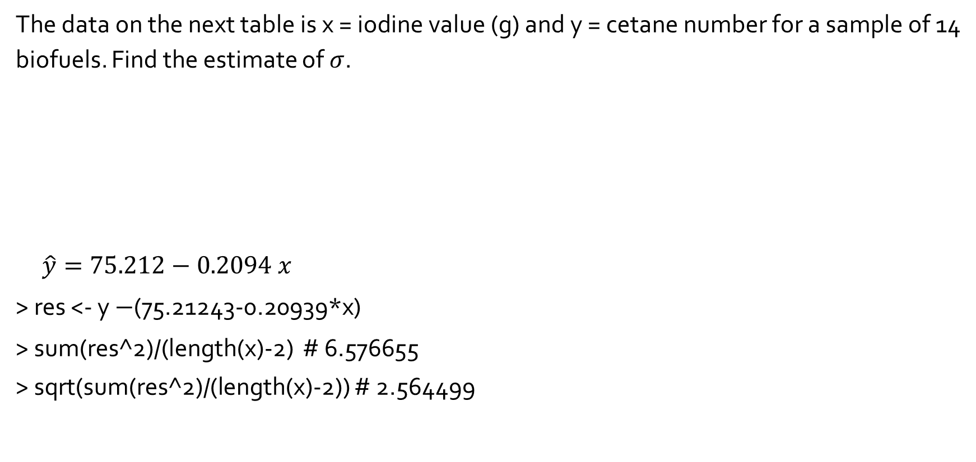
Example 12.4
The data on the next table is x = iodine value (g) and y = cetane number for a sample of 14 biofuels. Find the estimate of $σ$.
$\hat{y}=75.212−0.2094$ $x$
> res <- y $−$(75.21243-0.20939*x)
> sum(res^2)/(length(x)-2) # 6.576655
> sqrt(sum(res^2)/(length(x)-2)) # 2.564499
x | 132.0 129.0 120.0 113.2 105.0 92.0 84.0 83.2 88.4 59.0 80.0 81.5 71.0 69.2
y | 46.0 48.0 51.0 52.1 54.0 52.0 59.0 58.7 61.6 64.0 61.4 54.6 58.8 58.0
Fit | 47.57 48.20 50.09 51.51 53.23 55.95 57.62 57.79 56.70 62.86 58.46 58.15 60.35 60.73
Residual | -1.57 -0.20 0.91 0.59 0.77 -3.95 1.34 0.91 4.90 1.14 2.94 -3.55 -1.55 -2.725

